Slide 1
List
Notes:
Welcome to the session on List

Slide 2

In this Module You will learn
Identify List data structure
Illustrate the use of indexing and slicing
Employ various list operations to manipulate data
Apply list comprehension to create, map and filter data
Notes:
After completing this module, you will be able to,
Identify List data structure
Illustrate the use of indexing and slicing
Employ various list operations to manipulate data
Apply list comprehension to create, map and filter data

Slide 3
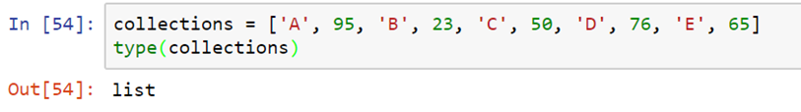
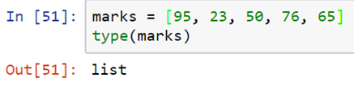
List
Let us understand the LIST data structure in detail
It is a data structure that contains ordered collection of elements
It can contain numbers, strings, and any other data structures in an arbitrarily nested, heterogeneous fashion
A list is surrounded by square brackets, and items are separated by comma
List will be retaining the order in which they are created, unlike set. Hence indexing is completely possible.
Elements in a list is completely mutable, that is we can change them at any point in time
List and string indexing works in the same fashion
Notes:
Let's learn in detail about the important data type called list. List (or array) is a data structure that contains an ordered collection of elements. Lists can contain numbers, strings, and any other data structures in an arbitrarily nested, heterogeneous fashion. A list is surrounded by square brackets, and items are separated by a comma. The list will be retaining the order in which they are created, unlike set. Hence indexing is completely possible. Elements in a list are completely mutable, that is, it is possible to change them at any point in time. List and string indexing work in the same fashion.

Slide 4

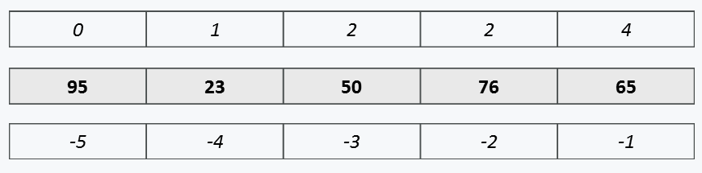
List indexing
Let us understand the concept behind List indexing
Length of a list is the number of elements in the list.
Use len() function to find out the length
Positive Indexing
Starts from 0 to length - 1
Negative indexing can be used to access element in reverse direction
Notes:
Lets understand more about list indexing. As mentioned earlier, the elements in the list can be accessed using their position. Our marks list contains 5 elements, which can be computed using len function. Index of the first element in the list is 0. Index of second element is 1 and so on. Since the index starts from 0, the index of last element in marks list is 4, that is, length of the list minus one. This type of indexing where the index starts from 0 and goes till length of the list minus one is called Positive Index.
The same is represented for each element here. The values in the middle represents the elements in the list. On top of these, we have represented the positive indexes. Similar to positive index, python supports negative indexing to access elements in reverse direction. For example, the last element here, which is 65 will have the index as -1. The second last element which is 76, will have index as -2, likewise the index grows in negative direction. For the first element in our list, the negative index is -5.
Hence, elements in the list can be accessed by using either positive indexing or negative indexing.

Slide 5



Accessing elements using positive index
Let us understand how to access elements in list using a positive index
SAMPLE DATA
Access last element in the list by subtracting the number of elements in list with one.
We need to subtract with one because, the index starts from 0
Example 1
Example 2
Example 3
Notes:
Accessing elements using positive index is pretty simple. In Python, the index always start from 0, like Matlab or Fortran. While indexing, we need to specify the index of the element within square brackets. In this example, we are trying to access the first element using marks of zero. Accessing the second element in the list can be achieved using marks of one. If we want to access the last element in the list, first we need to know, the total number of elements in the list. This can be computed using length function. To this value, if we subtract one, we can get the index of the last element. Here, marks of length of marks minus 1 returns 65.

Slide 6



Accessing elements using negative index
Let us understand how to access elements in list using a negative index
SAMPLE DATA
Example 1
Example 2
Example 3
Negative indexes are handy if we want to access the elements from the end.
To access the last element, we need not calculate the length and subtract one (like the previous example using positive index), instead we can directly use -1 as index
Access first element using negative index. For accessing first element, positive index is handy and most preferred
Accessing the second last element from the list
Notes:
Negative indexes are handy, if we want to access the elements from the end. To access the last element, we need not calculate the length and subtract one (like the previous example using positive index). Instead, we can directly use MINUS 1 as index. Minus two can be used as index to access the second last element from the list. To access the first element using negative index, we can compute the length of the index and add negative symbol.
For accessing the first element, positive index is handy and most preferred. To access the last element, negative index is handy. But both these indexes are equivalent and can be used according to the convenience of the developer. Hence, every element in the list will have a positive index as well as negative index.

Slide 7
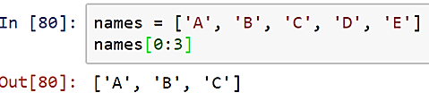


List slicing
Let us understand the LIST SLICING operation in detail
List slicing can be used to access more than one element at a time.
Or we can also used it to subset a origin list.
Example 3
Example 1
Example 2
Ignore the starting number, if you want all the elements of the list from the beginning
Slicing all the elements from third position (ignoring third element)
Slice first three elements in the list:
Notes:
In the previous example, we learnt how to access a specific element from the list using index. By extending further, we can use list slicing to access more than one element at a time. At times, we can use list slicing to subset an origin list. In this example, we are slicing the first three elements using their index and colon operator. The index towards the left side of the colon represents the starting index. The index towards the right side of the colon represents the ending position for slicing. Here, names from 0 to 3, returns elements from index 0 to index 3 minus 1.
To get the same result, we can also simply ignore the starting number. This will return all the elements from the beginning till index 3 minus 1.

Slide 8
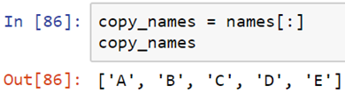
List cloning
Let us understand the concept behind List Cloning
Slice all the elements to make a copy or clone of a list.
If list are not cloned, any changes in the new list will also affect the original list.
Example
Notes:
In the last example, we learnt how to access more than one element from the list using index slicing. By extending further, we can make a copy or clone of a list. If list is not cloned, any changes in the new list will also affect the original list. The code snippet shows how a clone for the list names is created. If you don't specify the start and end index while slicing, the entire list is selected and assigned or copied into the specified list object variable; here it is copy underscore names.

Slide 9
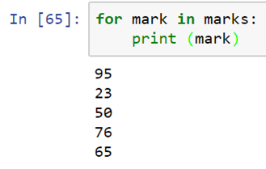
Accessing elements of list using for loop
Let us understand how to access elements of a list using for loop
For loop can be used to iterate over elements in list
It is not required to initialize a variable, maintain any counter and set condition to terminate the loop
Note :
Snippets inside the for loop should be indented.
Print statement is indented using four spaces
The words “for”& “in” are keywords
Notes:
Let’s learn how to access all the elements in a list. For loop can be used to iterate over all or subset of elements in a list. In python the syntax for loops are simple and intuitive. It is not required to initialize variable, maintain any counter and set condition to terminate the loop, like in few other languages like C, JavaScript etc. Instead, we can used a temporary variable inside the for loop statement to get one value at a time. In this example, the temporary variable is mark. For mark in marks, denote that every time the loop runs, the mark variable will have one element from the list marks. The number of iteration is equal to the total number of elements in the list. We need to close the for loop’s first line by colon operator, to let python know that for loop starts here.
The code snippets inside the for loop should be indented. Indentation is nothing but adding some spaces before each line of code inside the for loop. All the lines inside a for loop should have same indentation. This lets python know the starting and ending lines of code pertaining to a specific for loop. In this example, the print statement is indented using four spaces, which is the standard number of spaces that is widely used. Indentation is a very important property in python. Using this for loop, we are trying to print one element at a time from our marks list. Mark is the temporary variable created to iterate over each element. Apart from this, the other words are for and in, which are keywords.

Slide 10
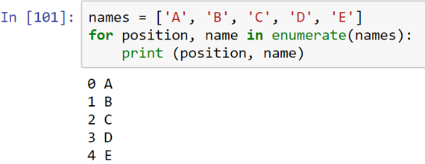
Accessing elements with position
Let us understand how to access elements of a list with position
By default, we can directly access the elements without worrying about index.
But in certain situations, the index is also required, In such situations, enumerate() function comes handy.
The enumerate() function adds a counter to an iterable.
For each element in cursor, a tuple is produced with (counter, element) format.
For loop binds the position (i.e. the variable position in our example) and value of the element in that position (i.e. name).
Notes:
We can access the list elements without using its index. But, there can be some scenarios in which we will need to access the elements using index.
There, we can use the function enumerate which add a counter to an iterable. The ‘for loop’ binds the position, that is, the index and the value of
the element in that position.

Slide 11
Importance of indentation
Lets discuss the importance of indentation
Python does not have explicit begin or end curly braces to mark where the for loop starts and where it ends.
Instead, a leading whitespace called indentation, is used to determine the grouping of statements inside a for loop, conditional statements, function etc.
The leading whitespaces (spaces and tabs) at the beginning of a logical line is used to compute the indentation level of the line.
This means that leading whitespaces before any python code is significant and can make huge difference in calculation if not used properly.
Within a single for loop, conditional statements, functions etc., the number of leading white space given should be consistent.
As per python standards, one level of indent should have four white spaces (not tabs).
Notes:
Like in other languages such as C, Java, etc. , python does not have curly braces to mark the begin and end of the ‘for loop’, conditional statements, ‘functions’, etc.
Python uses a leading whitespace (spaces or tabs) called indentation for this purpose. So leading whitespaces before any Python code is significant.
The number of leading white space given should be consistent. As per python standards, one level of indent should have four white spaces (not a tab space).

Slide 12
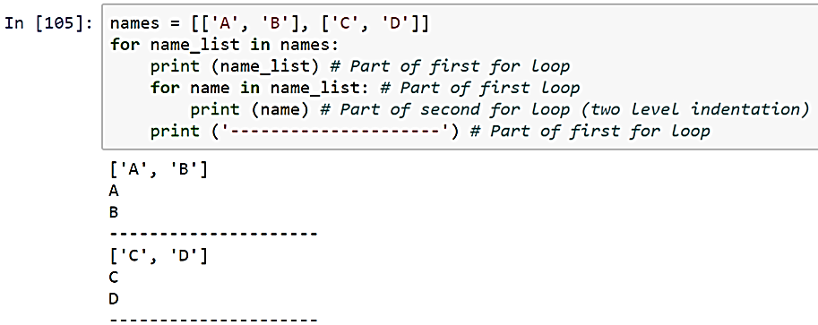
Multilevel Indentation
Let us understand multilevel indentation
indented with four white spaces
indented twice – Eight white space
indented with only level (i.e. four spaces), hence it is part of first for loop
Notes:
In Python, some times we have to use multilevel indentation. Here in this example, the statements under the first first ‘for loop’ are indented with four white spaces.
In the next ‘for loop’ statements are indented twice, that is, eight white spaces. The last statement is indented with only with four spaces; so this means, it is the part of first ‘for loop’.

Slide 13
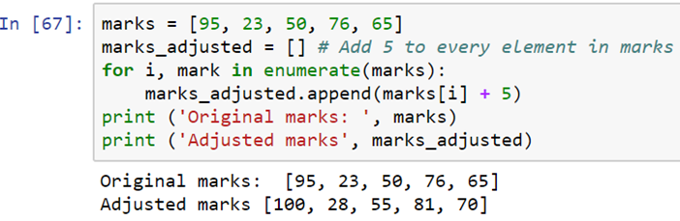
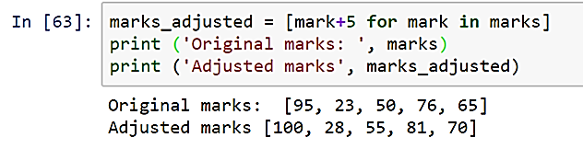
List Comprehension
Let us understand the LIST comprehension in detail
Python supports a compact way to manipulate item by item in a list using list comprehensions.
They may contain any number of nested lists, combined with conditional expressions if desired.
Scenario:
Add 5 marks to existing set of marks
Solution :
Create an empty list
Use FOR LOOP to access each mark in the marks list
Add 5 to it and finally appended the mark one by one to the new list
Instead of using for loop separately, we can use the for loop inside the new list itself
Notes:
List comprehension in Python is a compact way of manipulating items in a list. List comprehension may contain any number of nested lists,
combined with conditional or looping expressions. In the given example, an original list of mark is iterated using a ‘for loop’ and 5 is added to the list to get the adjusted marks.
The next code cell contains the code ,which uses the list comprehension to perform the same task. It uses the ‘for loop’ inside the new list itself.

Slide 14
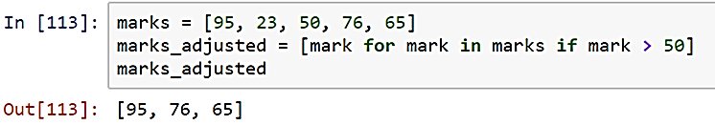
List Comprehension
Let us understand the LIST comprehension in detail
Scenario:
Extract marks which are greater than 50
Solution :
Use for loop & if condition in a single list using list comprehension. This avoids multiple lines of code
Notes:
The given code snippets depict how to extract marks that are greater than 50, using list comprehension. It uses for loop and if condition in a single list.
So that, we can avoid multiple lines of code.

Slide 15
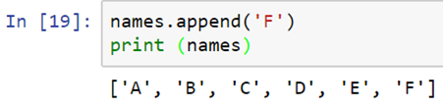
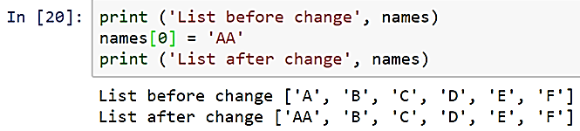
Adding elements in list
Let us understand adding elements into list
Use append() function to add elements in the end
Note: append() does not return anything. Hence left assignment is not required
List elements can be modified using their index
Notes:
Whenever we need to add an element to the end of a list, we should use append method, which does not return anything . That means, in place changes will be happening to the list. Also, we can change the list elements by using their index, as depicted in the sample code.

Slide 16
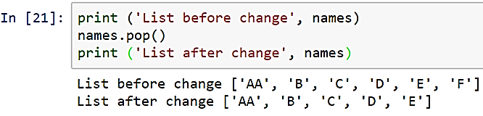
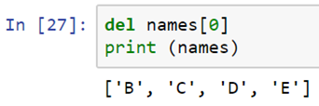
Deleting elements in list
Let us understand how to delete elements in a list
List elements can be removed from the end using pop() function
Elements can be removed in anywhere (using index) in the list using del
Note: Both pop() and del methods does not return anything. Hence left assignment is not required
Notes:
When we need to delete an element from the end of the list, we can use the function pop and for deleting an element from any position from the list , we can use the ‘del’ command along with list index.

Slide 17
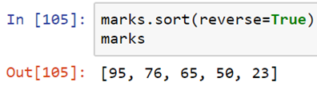
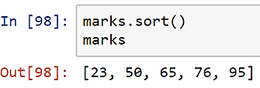
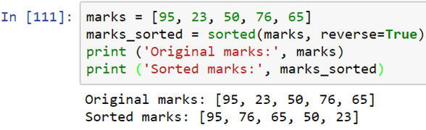
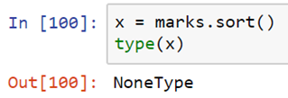
List Sorting
Let us understand the LIST data structure in detail
Elements in the list can be sorted using “.sort()” function.
By default the function sorts elements in ascending order.
The sort(reverse=True) for descending sort.
Alternatively we can sorted() function to avoid in-place sorting.
The sorted values can be stored in another variable without changing the original list.
The sort() function alters the original list directly and returns None.
Notes:
When we need to sort the list elements, we can make use of the function sort. By default, this function sorts the elements in ascending order.
If you want to sort the list in descending order, pass ‘reverse equal to true’ as the parameter to the sort method.
Also we can use ‘sorted’ method to avoid in-place sorting.
So that, the original list will not get changed.

Slide 18
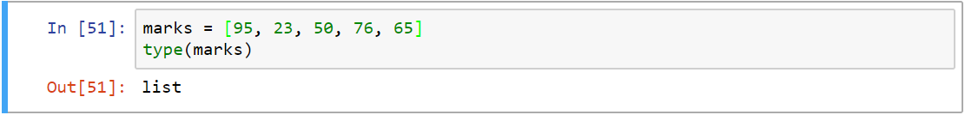
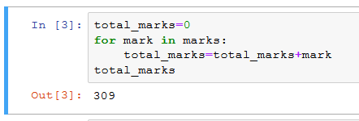
Sample Code 1
Problem:
Solution:
Notes:
Observe the sample program which helps us to calculate the total marks using list.
Define a list called marks which contains 5 marks. Later, using for loop , iterate through each marks and in each iteration, the mark is Getting added to the object variable ‘total_marks’. Finally print the total_marks variable.

Slide 19
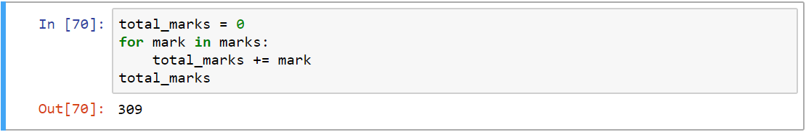
Sample Code 1 – alternate solution
Use “+=“ to add right operand to the left, as
shown below:
Use inbuilt sum() function to calculate the
total marks
Notes:
There are some alternate solutions to find out the sum of elements in a list. In the first sample code depicts the usage of short hand operators “+=“ to add the right operand to the left .
The second sample code depicts the usage of the in-built method sum() to add the elements in a list.

Slide 20
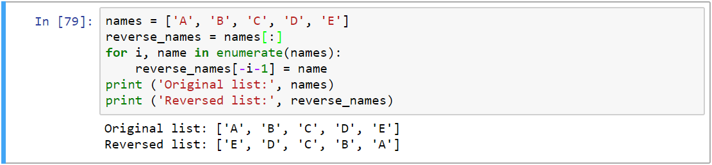
Sample Code 2
Problem: Reverse the following list
Solution:
Notes:
This is an example for reversing the elements in a list.
In this program, the list “names” contains a list of elements and copying of these elements into another list named ‘reverse_names’. Then iterating the names list and fetching the index and value of each list elements from the first index to the last index . Then, re-assigning into the reverse_names list from the last index to the first index. Then displaying both the lists.

Slide 21
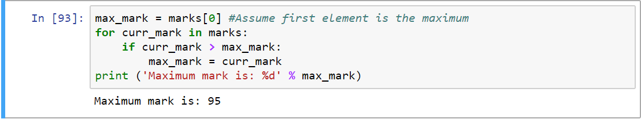
Sample Code 3
Problem: In the following list,
identify the maximum marks
Solution:
Notes:
Observe the given program to find out the maximum marks from a list. We can solve this problem in different ways.
In the first solution , finding the highest mark by iterating each element in the list and store the highest mark in the max_mark variable.
In the second solution , using the in-built method ‘max()’ finding the highest value.

Slide 22
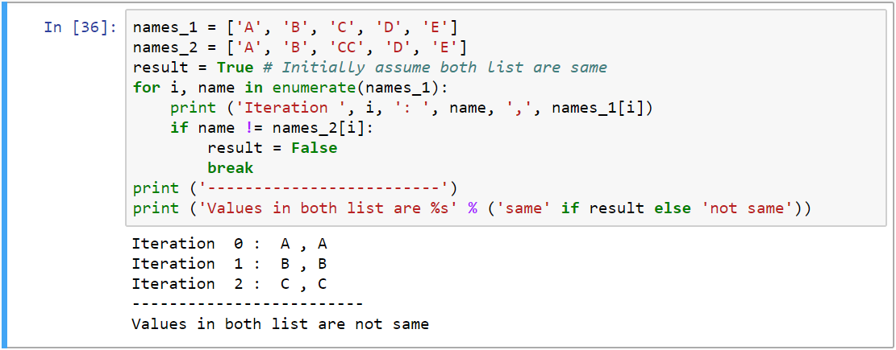
Sample 4
Problem: Compare and conclude if below two list are equal or not
Solution:
Notes:
This is a program which helps us to compare and find out if two lists are equal or not. In the sample code, we defined two list variables: name_1 and name_2. Initially, we assume that both the lists are same, so assigned a true boolean value to the ‘result’ variable.
Then iterate the names_1 variable and fetch each element’s index and value and then, compare that value with the elements in the names_2 list.
If they are not equal the ‘result’ variable is assigned with boolean value ‘false’ and stop the iteration. Otherwise it has to continue the iteration and check the elements till the end of the list. Then print the message “same” if elements are same . Else print the message “not same”.

Slide 23

In this Module You have learnt to
Identify List data structure
Illustrate the use of indexing and slicing
Employ various list operations to manipulate data
Apply list comprehension to create, map and filter data
Notes:
Having completed this session you would have learnt to,
Identify List data structure
Illustrate the use of indexing and slicing
Employ various list operations to manipulate data
Apply list comprehension to create, map and filter data

Slide 24
Thank You
Notes:
Thank You

